Slide 1

Called to seek the
well-being of all
NT-NL SYNOD PUBLIC WITNESS TEAM
Your voice. Your neighbor. Your vote.
A 2026 NONPARTISAN VOTING RESOURCE
FOR TEXAS CONGREGATIONS
Notes:
Welcome. This is a nonpartisan voting resource from the NT-NL Synod Public Witness Team. The ELCA and NT-NL Synod do not endorse or oppose political candidates or parties.

Slide 2
Voting as a way of loving our neighbor
OUR CALLING
In baptism, we are called to love and serve our neighbors.
Informed participation in civic life, including voting, is one way we live that calling.
Your voice.
Your neighbor.
Your vote.
Notes:
Faith framework: ELCA Faith and Civic Life: Seeking the Well-being of All (2025).

Slide 3
Questions for faithful discernment
AS YOU PREPARE TO VOTE, CONSIDER
?
What will promote the well-being of all?
?
How will these choices affect our most vulnerable neighbors?
?
Is the information guiding me accurate and trustworthy?

Slide 4
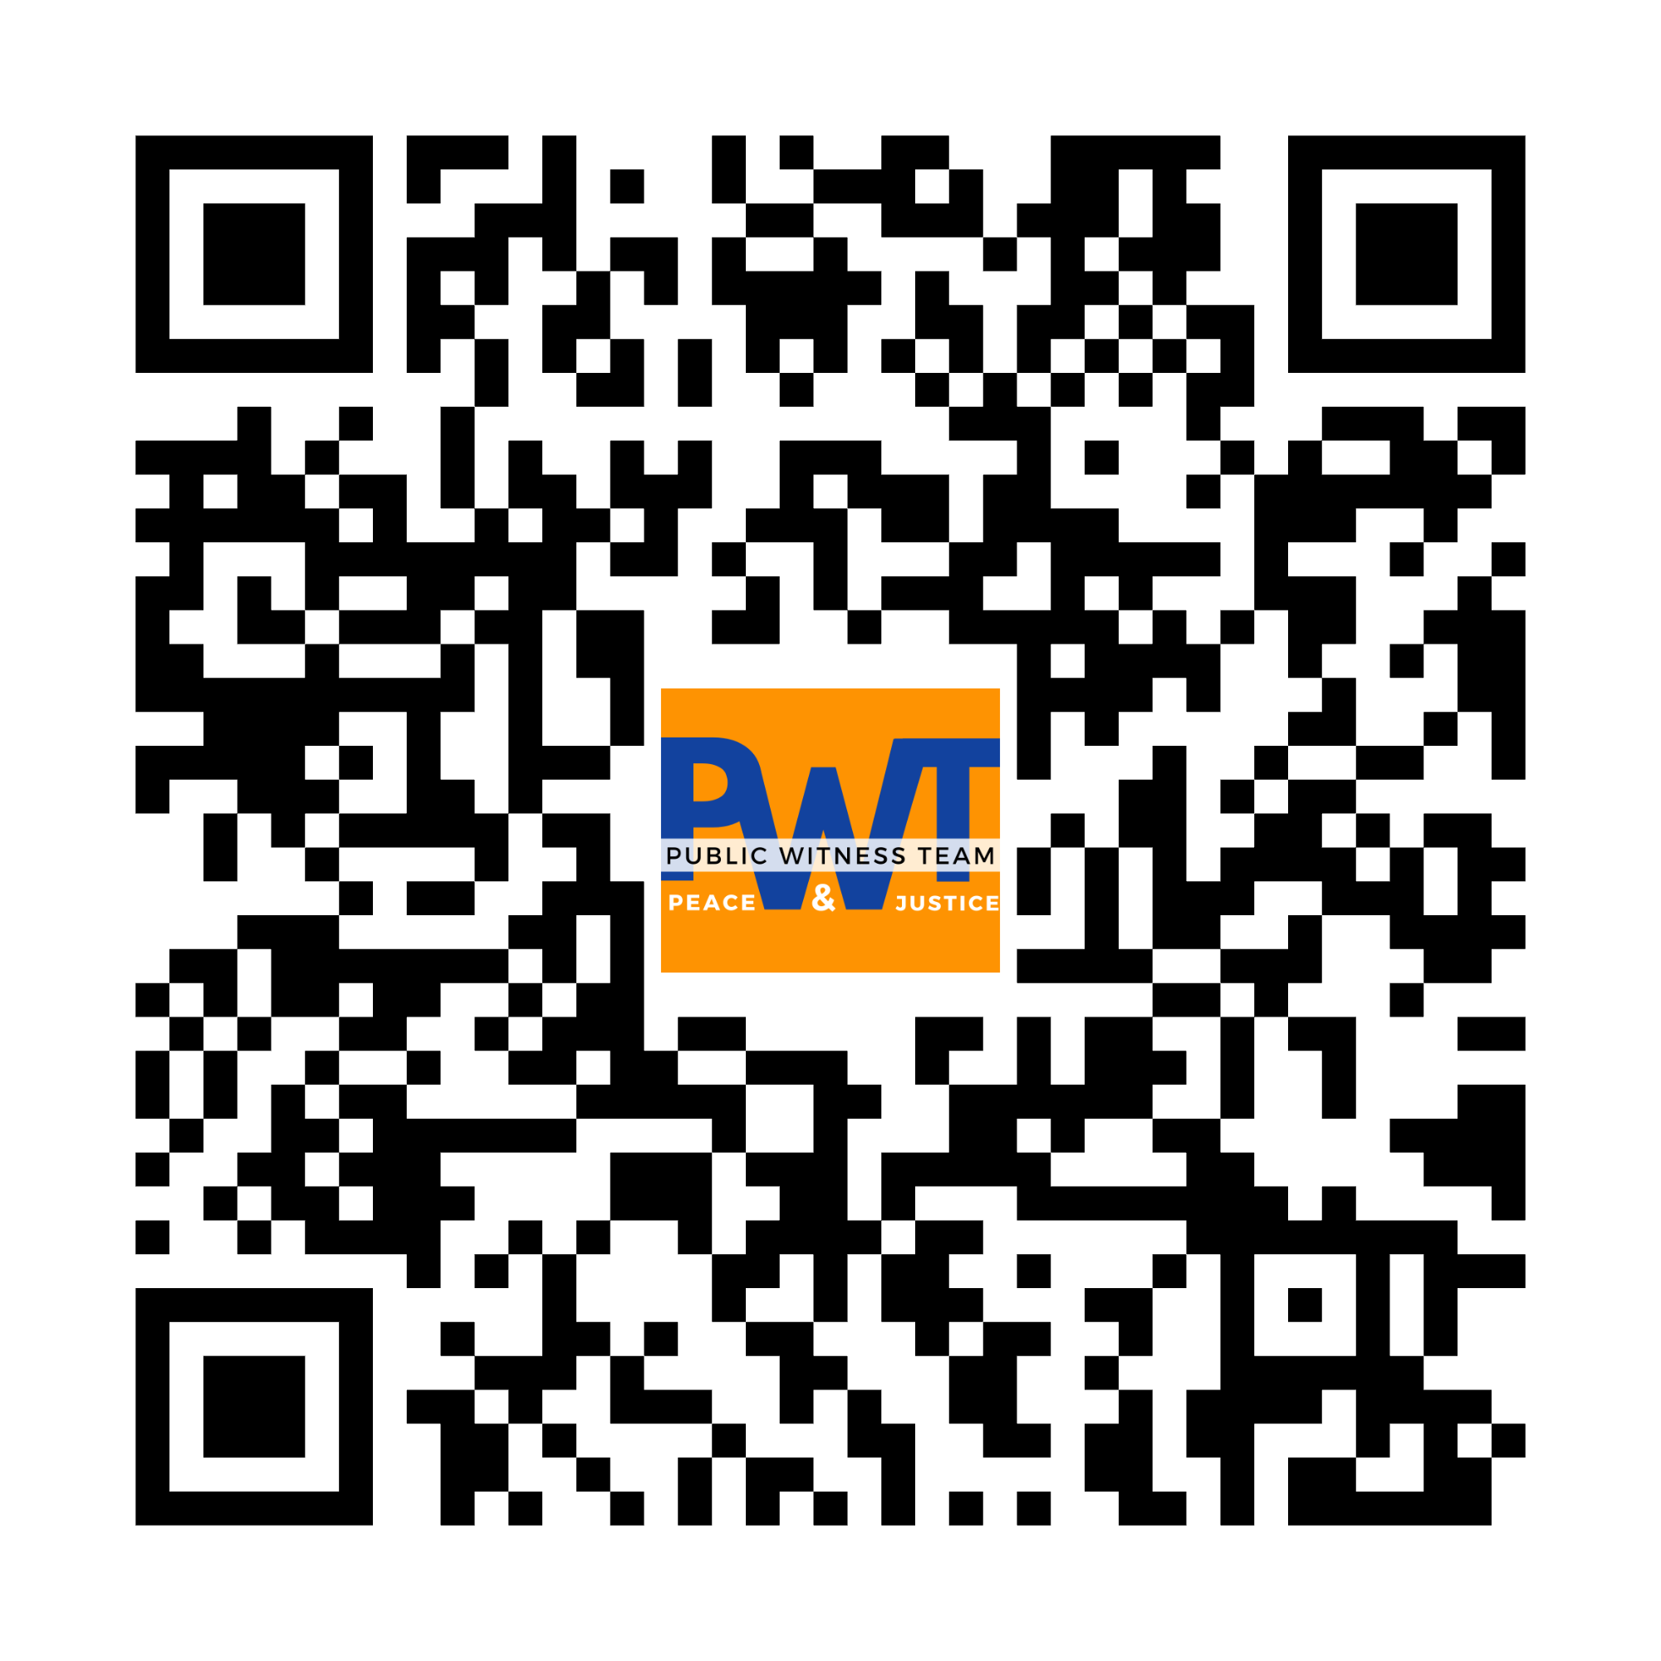
Where to find trustworthy information
NONPARTISAN VOTING RESOURCES
BallotReady.org
TEXAS VOTER RESOURCES
Personalized ballot, candidates and voting plan
VoteTexas.gov
Official registration, polling and ID information
VOTE411.org
League candidate responses and voter guide

Slide 5
Key dates to remember
2026 TEXAS GENERAL ELECTION
OCT 5
OCT 19
OCT 23
OCT 30
NOV 3
Register to vote or update your address
Early voting begins
Mail-ballot application must be received*
Early voting ends
Election Day — polls open 7 a.m.–7 p.m.
*Texas vote-by-mail eligibility rules apply; see VoteTexas.gov. Election dates verified September 14, 2026.

Slide 6
Prepare. Learn. Discern. Vote.
YOUR VOTING PLAN
1
2
3
Check your registration and address.
Preview your ballot and compare candidates.
Choose when and where you will vote.

Slide 7
PREPARE. LEARN. DISCERN. VOTE.
Your voice.
Your neighbor.
Your vote.
This resource is nonpartisan.
The ELCA and NT-NL Synod do not endorse or oppose political candidates or parties.
Faith framework: ELCA Faith and Civic Life: Seeking the Well-being of All (2025).
Election dates verified September 14, 2026. Check VoteTexas.gov for updates.

